Slide 1

Vinitha Jain
Ms Nalini Sampath
Dr Tripty Singh

Slide 2
History of OOP
1960- Simula
1970- Dynabook, smalltalk
1980-Ada
1990-Object oriented Methods
Later– OMT, OOSE

Slide 3
Structured programming
Structured programming is a programming paradigm aimed at improving the clarity, quality, and development time of a computer program by making extensive use of the structured control flow constructs of selection (if/then/else) and repetition (while and for), block structures, and subroutines.

Slide 4
Structured programming
Structured Programming Approach, as the word suggests, can be defined as a programming approach in which the program is made as a single structure. It means that the code will execute the instruction by instruction one after the other. It doesn’t support the possibility of jumping from one instruction to some other with the help of any statement like GOTO, etc. Therefore, the instructions in this approach will be executed in a serial and structured manner. The languages that support Structured programming approach are:
C
C++
Java
C#..etc

Slide 5
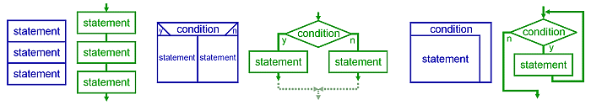
Structured programming
Graphical representation of the three basic patterns — sequence, selection, and repetition — using NS diagrams (blue) and flow charts (green)

Slide 6
Structured Programming in Everyday Life
1. Sequence Execute a list of statements in order.
Example: Baking BreadAdd flour.
Add salt.
Add yeast.
Mix.
Add water.
Knead.
Let rise.
Bake.

Slide 7
2. Repetition Repeat a block of statements while a condition is true.
Example: Washing DishesStack dishes by sink.
Fill sink with hot soapy water.
While moreDishes
Get dish from counter,
Wash dish,
Put dish in drain rack.
End While
Wipe off counter.
Rinse out sink.

Slide 8
3. Selection Choose at most one action from several alternative conditions.
Example: Sorting MailGet mail from mailbox.
Put mail on table.
While moreMailToSort
Get piece of mail from table.
If pieceIsPersonal Then
Read it.
ElseIf pieceIsMagazine Then
Put in magazine rack.
ElseIf pieceIsBill Then
Pay it,
ElseIf pieceIsJunkMail Then
Throw in wastebasket.
End If
End While

Slide 9
If-Then-Else Statements Execute the first action whose corresponding condition is true. Here is the general form:If condition1 Then
action1
ElseIf condition2 Then
action2
ElseIf condition3 Then
action3
Else
defaultAction
End If
Example:
If n = 1 Then
WriteLine("One")
ElseIf n = 2 Then
WriteLine("Two")
ElseIf n = 3 Then
WriteLine("Three")
Else
WriteLine("Many")
End If

Slide 10
Switch case
Select Statement Execute the action corresponding to the value of the expression.Select Case value1
Case value1
action1
Case value2
action2
Case value3
action3
Case Else
defaultAction
End Select
Example:
Select Case n
Case 1
WriteLine("One")
Case 2
WriteLine("Two")
Case 3
WriteLine("Three")
Case Else
WriteLine("Many")
End Select

Slide 11
Structured Programming in Visual Basic
Sequence. Lines or blocks of code are written and executed in sequential order. Example:
x = 5
y = 11
z = x + y
WriteLine(z)
2. Repetition. Repeat a block of code (Action) while a condition is true. There is no limit to the number of times that the block can be executed.While condition
action
End While, Example:
x = 2
While x < 100
WriteLine(x)
x = x * x
End

Slide 12
Structured Programming in Visual Basic
3. Selection. Execute a block of code (Action) if a condition is true. The block of code is executed at most once.If condition Then
action
End If
Example:
x = ReadLine()
If x Mod 2 = 0
WriteLine("The number is even.")
End If
Definite Repetition (For Loop) Combine initialization, checking a condition, and incrementing a counter in a single statement called a for statement. Here is the general form:
For i = 1 To n Step k ' Step k is optional
action
Next
Example:
For i = 1 To 20
WriteLine(i)
Next i
Example:
For i = 20 To 1 Step -1
WriteLine(i)
Next

Slide 13
Advantages of Structured Programming Approach:
Easier to read and understand
User Friendly
Easier to Maintain
Mainly problem based instead of being machine based
Development is easier as it requires less effort and time
Easier to Debug
Machine-Independent, mostly.

Slide 14
Disadvantages of Structured Programming Approach:
Since it is Machine-Independent, So it takes time to convert into machine code.
The converted machine code is not the same as for assembly language.
The program depends upon changeable factors like data-types. Therefore it needs to be updated with the need on the go.
Usually the development in this approach takes longer time as it is language-dependent. Whereas in the case of assembly language, the development takes lesser time as it is fixed for the machine.

Slide 15
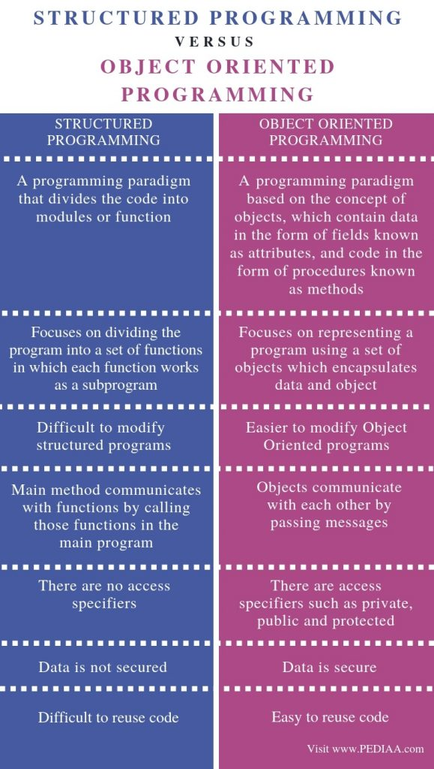


Slide 16
  Object-oriented programming (OOP) is a programming paradigm using "objects" – data structures consisting of data fields and methods together with their interactions – to design applications and computer programs. Programming techniques may include features such as data abstraction, encapsulation, messaging, modularity, polymorphism, and inheritance. Many modern programming languages now support OOP.

Slide 17

  A programming paradigm is a fundamental style of computer programming. Paradigms differ in the concepts and abstractions used to represent the elements of a program (such as objects, functions, variables, constraints, etc.) and the steps that compose a computation (assignment, evaluation, continuations, data flows, etc.).

Slide 18
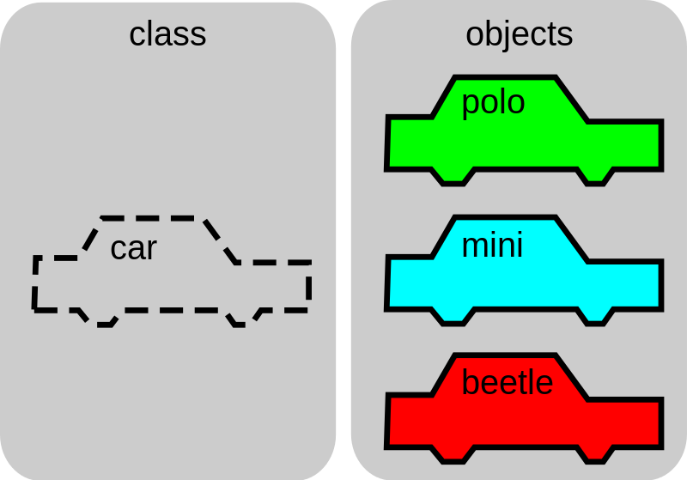
Classes and Objects

Slide 19
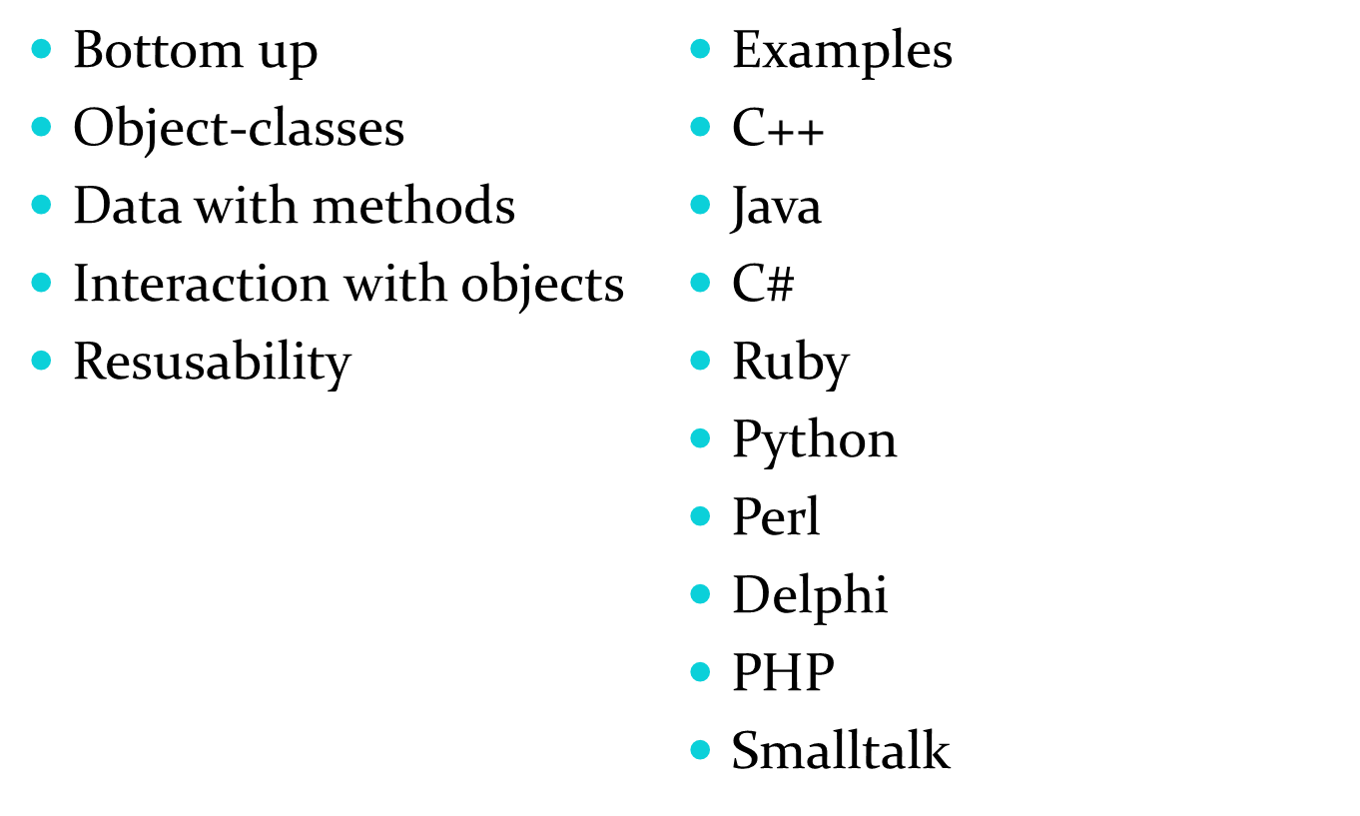
Important features of OOP

Slide 20

  In object-oriented programming, a class is a construct that is used as a blueprint to create instances of the class (class instances, class objects, instance objects or just objects). A class defines constituent members which enable class instances to have state and behavior. Data field members (member variables or instance variables) enable a class object to maintain state. Other kinds of members, especially methods, enable a class object's behavior. Class instances are of the type of the associated class.
  For example, an instance of the class "Fruit" (a "Fruit" object) would be of the type "Fruit". A class usually represents a noun, such as a person, place or (possibly quite abstract) thing. Programming languages that include classes as a programming construct subtly differ in their support for various class-related features. Most support various forms of class inheritance. Many languages also support advanced encapsulation control features, such as access specifiers.

Slide 21

  Object is an run time entity.
  Is an Instance of class
  Represents a Place ,Person ,anything that have some attributes.

Slide 22

  There is a very important distinction between an object and an instance of an object. An object is actually a definition, or a template for instances of that object. An instance of an object is an actual thing that can be manipulated. For instance, we could define a Person object, which may include such member data as hair color, eye color, height, weight, etc. An instance of this object could be "Dave" and Dave has values for hair color, eye color, etc. This allows for multiple instances of an object to be created.

Slide 23

  Data encapsulation, sometimes referred to as data hiding.
  Data Encapsulation and Data Abstraction is one of the most striking feature of object oriented programming.
  The wrapping up of data and code into a single unit is called data encapsulation. The data is not accessible to the outside world only those functions which are wrapped into a class can only access the private data of the class.
Contd…

Slide 24

  The concept of data encapsulation is supported in C++ through the use of the public, protected and private keywords which are placed in the declaration of the class.
  Note :
  Anything in the class placed after the public keyword is accessible to all the users of the class
  Elements placed after the protected keyword are accessible only to the methods of the class or classes derived from that class
  Elements placed after the private keyword are accessible only to the methods of the class.

Slide 25

  Inheritance is one of the most striking feature of object oriented programming.
  Inheritance is the process by which one class can acquire the properties of another class.
  The new classes, known as subclasses (or derived classes), inherit attributes and behavior of the pre-existing classes, which are referred to as superclasses (or ancestor classes). The inheritance relationships of classes gives rise to a hierarchy
Contd…

Slide 26
  A superclass, base class, or parent class is a class from which other classes are derived. The classes that are derived from a superclass are known as child classes, derived classes, or subclasses.
  In object-oriented programming (OOP), inheritance is a way to compartmentalize and reuse code by creating collections of attributes and behaviors called objects which can be based on previously created objects.

